Slide 1

K-Means clustering.
DATA ANALYTICS | IRONHACK

Slide 2

K-Means
To use this method we need to specify the desired amount of clusters “K” beforehand and it use the following iterative procedure
Then, this method generates “K” random locations (named “centroids”) by assigning random values to every feature of the dataset.
Next, the distance between each observation and the centroids is computed.
Every observation is assigned to the nearest centroid.
The location of the “centroids” is replaced by the mean location of all the observations assigned to the centroid.
Repeat the steps 2-4 a fixed number of times or until the change of the “centroids” locations is smaller than a given value (whatever happens first)

Slide 3
Sklearn
K-Means is a clustering method which can be found in: sklearn.cluster
from sklearn.cluster import KMeans
K-Means works better when the features had been previously scaled with the StandardScaler() as is sensitive to the scale.
Link1 Link2
As an object, K Means() works similarly to a transformer, it has two methods fit() and predict():
K Means().fit(df)
K Means().predict(new_sc_samples)
Sklearn KMeans documentation
Scikit-learn KMeans

Slide 4
Sklearn
There are three main methods to determine the best K value:
Business restrictions/knowledge
Elbow method (not the best one)
Silhouette method
Scikit-learn KMeans best K?

Slide 5
Sklearn
Your boss demanded a specific number of groups? (money costs talks)
Does it makes sense to have so many or few groups?
What is a reasonable amount of groups?
KMeans best K: business restrictions

Slide 6
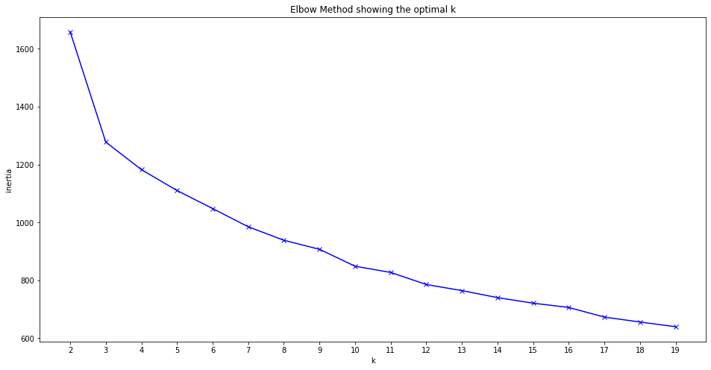
Sklearn
This method computes the average distance between every member of a cluster and the centroid of the cluster to which belongs as a function of the number of clusters.
The best number of clusters is the one for which previous amount doesn’t drop significantly.
KMeans best K: elbow method

Slide 7
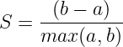
This method computes the “goodness” of the clustering based on:
Mean intracluster distance = a
Mean nearest cluster distance = b
The Silhouette score is given by:
The best number of cluster is selected among the ones with peaks.
KMeans best K: silhouette method

Slide 8

IRONHACK BOOTCAMP
PROS OF K-MEANS
Simple to implement.
Scales to large datasets.
Guarantees convergence.
Can use different starting positions of centroids.
Easy to adapt to new datasets.

Slide 9
IRONHACK BOOTCAMP
CONS OF K-MEANS
The K-value needs to be chosen beforehand.
Depends on the initial locations of the centroids (several different runs need to be tested).
Sensitive to sets of different sizes and shapes.
Sensitive to outliers.
Not suited to high number of features.

Slide 10
